Slide 1
Notes:
More Nutrition Education resources at www.nutritionfromthehart.com

Slide 2
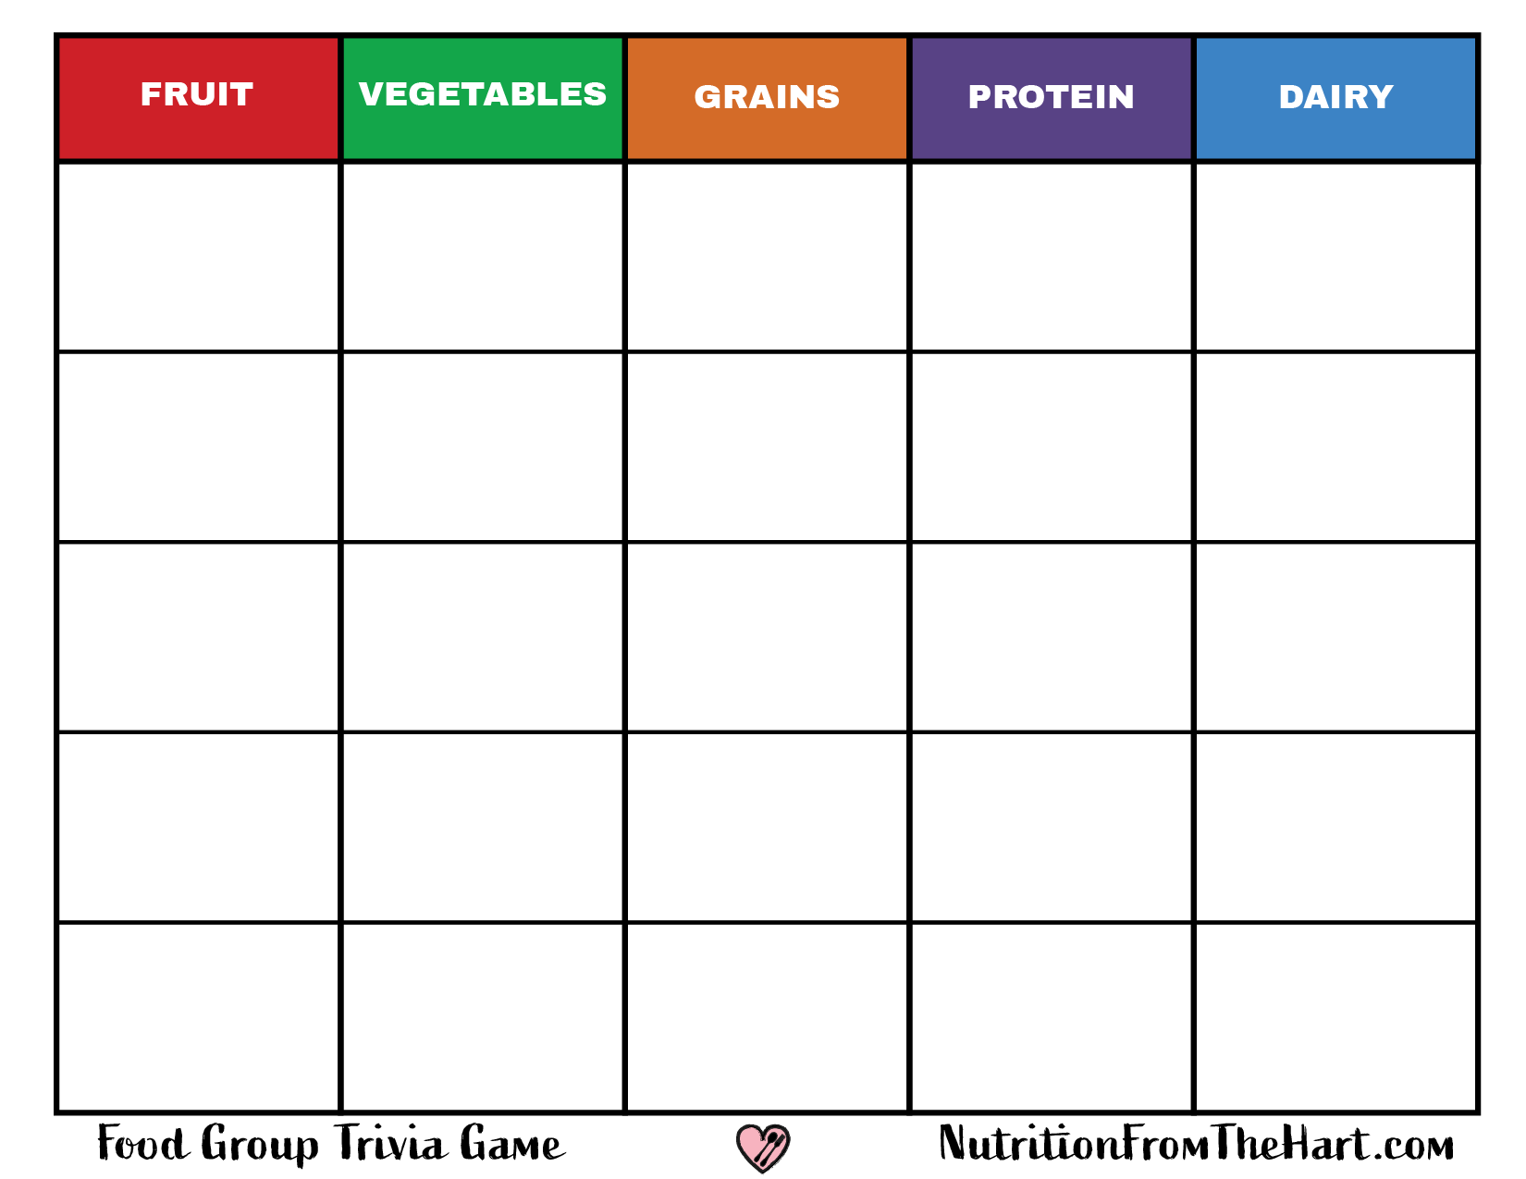
I grow on a tree. I’m high in fiber and my name rhymes with bear.
My main job is to give you beta-carotene to help your eyes and immune system.
I’m tiny, and when I’m brown, I’m a whole grain with healthy fiber. Stir fry me with veggies!
I’m a lean protein when grilled or roasted and not deep fried. Why did I cross the road?
A common source of the calcium you need. Drink me plain or add a little chocolate.
I give you loads of vitamin C and antioxidants. Add banana and make me a smoothie.
I give you tons of vitamins but I’m also high in fiber & protein. I grow in a pod with friends.
I’m a great meal in the morning, and a main ingredient in granola. I’m full of heart-healthy fiber.
I make milk, tofu, and many other things. I’m one of the best sources of plant protein.
So many to choose from! Swiss, sharp, blue, or Muenster. Choose low-fat when you can.
I’m a member of the rose family. I’m crunchy and I’m called cider when you drink me.
I’m a leafy green with many varieties. Add other veggies to me to make a healthy salad.
I make most of your bread and am most nutritious when eaten whole.
I’ve got your protein, plus heart healthy omega-3 fatty acids.
I’m packed with plant protein. When I’m fortified with calcium I’m a dairy alternative drink.
All of my potassium is good for your heart. I’m classified as a berry but I don’t look like one.
I can be spicy or sweet and when you crunch me I give you loads of vitamin C.
You looked for me as a veggie, but as a popped whole grain I make a healthy snack.
Complete protein in a perfect package. Just don’t drop me before I’m cooked.
Get your calcium in traditional or Greek versions. Mix me with granola and fruit for breakfast.
I’m a little hairy on the outside.
I’m packed with vitamin C and potassium inside.
I’m a root vegetable and pop up in salads. I give you vitamins, minerals and a bitter crunch.
My bread can be dark or marbled. I’m high in fiber and important minerals.
So many sizes and colors. I’m a plant-based powerhouse full of dietary fiber.
I’m a creamy drink full of calcium, but no lactose, for those who can’t tolerate it.
Notes:
CLUES Select and delete the point cards to display the clue underneath.

Slide 3
Pear
Carrot
Rice
Chicken
Milk
Strawberry
Peas
Oats
Soy
Cheese
Apple
Lettuce
Wheat
Fish
Soy Milk
Banana
Peppers
Corn
Eggs
Yogurt
Kiwi
Radish
Rye
Beans
Lactose-free Milk
Notes:
ANSWERS Select and delete the point cards to display the answer underneath.

Slide 4
Notes:
POINT CARD PAGE This page is provided so you can replace the cards after each game. Select all cards, copy (don’t cut), and then paste onto slides 1 and 2.

Slide 5
I grow on a tree. I’m high in fiber and my name rhymes with bear.
My main job is to give you beta-carotene to help your eyes and immune system.
I’m tiny, and when I’m brown, I’m a whole grain with healthy fiber. Stir fry me with veggies!
I’m a lean protein when grilled or roasted and not deep fried. Why did I cross the road?
A common source of the calcium you need. Drink me plain or add a little chocolate.
I give you loads of vitamin C and antioxidants. Add banana and make me a smoothie.
I give you tons of vitamins but I’m also high in fiber & protein. I grow in a pod with friends.
I’m a great meal in the morning, and a main ingredient in granola. I’m full of heart-healthy fiber.
I make milk, tofu, and many other things. I’m one of the best sources of plant protein.
So many to choose from! Swiss, sharp, blue, or Muenster. Choose low-fat when you can.
I’m a member of the rose family. I’m crunchy and I’m called cider when you drink me.
I’m a leafy green with many varieties. Add other veggies to me to make a healthy salad.
I make most of your bread and am most nutritious when eaten whole.
I’ve got your protein, plus heart healthy omega-3 fatty acids.
I’m packed with plant protein. When I’m fortified with calcium I’m a dairy alternative drink.
All of my potassium is good for your heart. I’m classified as a berry but I don’t look like one.
I can be spicy or sweet and when you crunch me I give you loads of vitamin C.
You looked for me as a veggie, but as a popped whole grain I make a healthy snack.
Complete protein in a perfect package. Just don’t drop me before I’m cooked.
Get your calcium in traditional or Greek versions. Mix me with granola and fruit for breakfast.
I’m a little hairy on the outside.
I’m packed with vitamin C and potassium inside.
I’m a root vegetable and pop up in salads. I give you vitamins, minerals and a bitter crunch.
My bread can be dark or marbled. I’m high in fiber and important minerals.
So many sizes and colors. I’m a plant-based powerhouse full of dietary fiber.
I’m a creamy drink full of calcium, but no lactose, for those who can’t tolerate it.
Notes:
CLUES A fresh copy with no point cards for easy viewing and printing.

Slide 6
Pear
Carrot
Rice
Chicken
Milk
Strawberry
Peas
Oats
Soy
Cheese
Apple
Lettuce
Wheat
Fish
Soy Milk
Banana
Peppers
Corn
Eggs
Yogurt
Kiwi
Radish
Rye
Beans
Lactose-free Milk
Notes:
ANSWERS A fresh copy with no point cards for easy viewing and printing.

