Slide 1


Slide 2
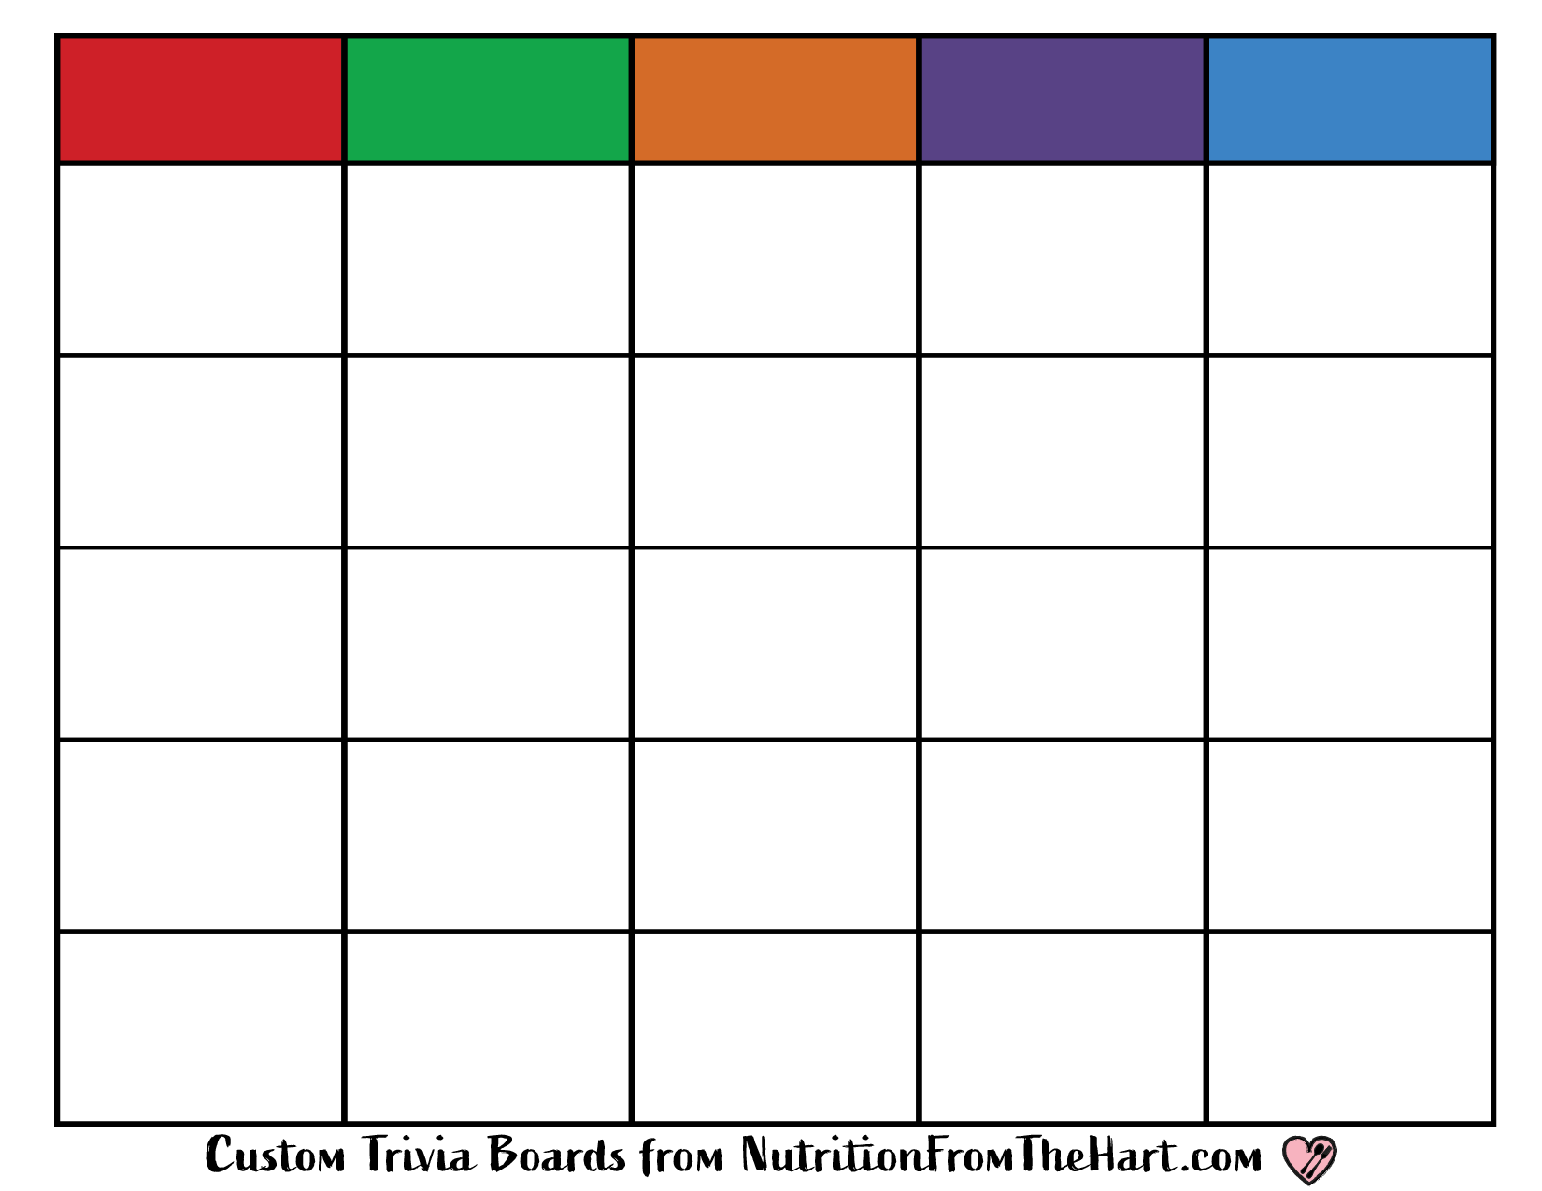
CATEGORY 1
CATEGORY 2
CATEGORY 3
CATEGORY 4
CATEGORY 5
Write
Question
In This
Space
Write
Question
In This
Space
Write
Question
In This
Space
Write
Question
In This
Space
Write
Question
In This
Space
Write
Question
In This
Space
Write
Question
In This
Space
Write
Question
In This
Space
Write
Question
In This
Space
Write
Question
In This
Space
Write
Question
In This
Space
Write
Question
In This
Space
Write
Question
In This
Space
Write
Question
In This
Space
Write
Question
In This
Space
Write
Question
In This
Space
Write
Question
In This
Space
Write
Question
In This
Space
Write
Question
In This
Space
Write
Question
In This
Space
Write
Question
In This
Space
Write
Question
In This
Space
Write
Question
In This
Space
Write
Question
In This
Space
Write
Question
In This
Space
Notes:
Step 1: Create categories and then type clues in each box. Step 2: Type your answers in the boxes on Slide Two. Step 3: Drag, select, and copy ALL of the color point cards from Slide Three. Step 4: Paste the cards over your clues on Slide One and your answers on Slide Two.

Slide 3
Answers 1
Answers 2
Answers 3
Answers 4
Answers 5
Write
Answers
In This
Space
Write
Answers
In This
Space
Write
Answers
In This
Space
Write
Answers
In This
Space
Write
Answers
In This
Space
Write
Answers
In This
Space
Write
Answers
In This
Space
Write
Answers
In This
Space
Write
Answers
In This
Space
Write
Answers
In This
Space
Write
Answers
In This
Space
Write
Answers
In This
Space
Write
Answers
In This
Space
Write
Answers
In This
Space
Write
Answers
In This
Space
Write
Answers
In This
Space
Write
Answers
In This
Space
Write
Answers
In This
Space
Write
Answers
In This
Space
Write
Answers
In This
Space
Write
Answers
In This
Space
Write
Answers
In This
Space
Write
Answers
In This
Space
Write
Answers
In This
Space
Write
Answers
In This
Space
Notes:
Step 1: Create categories and then type clues in each box. Step 2: Type your answers in the boxes on Slide Two. Step 3: Drag, select, and copy ALL of the color point cards from Slide Three. Step 4: Paste the cards over your clues on Slide One and your answers on Slide Two.

Slide 4
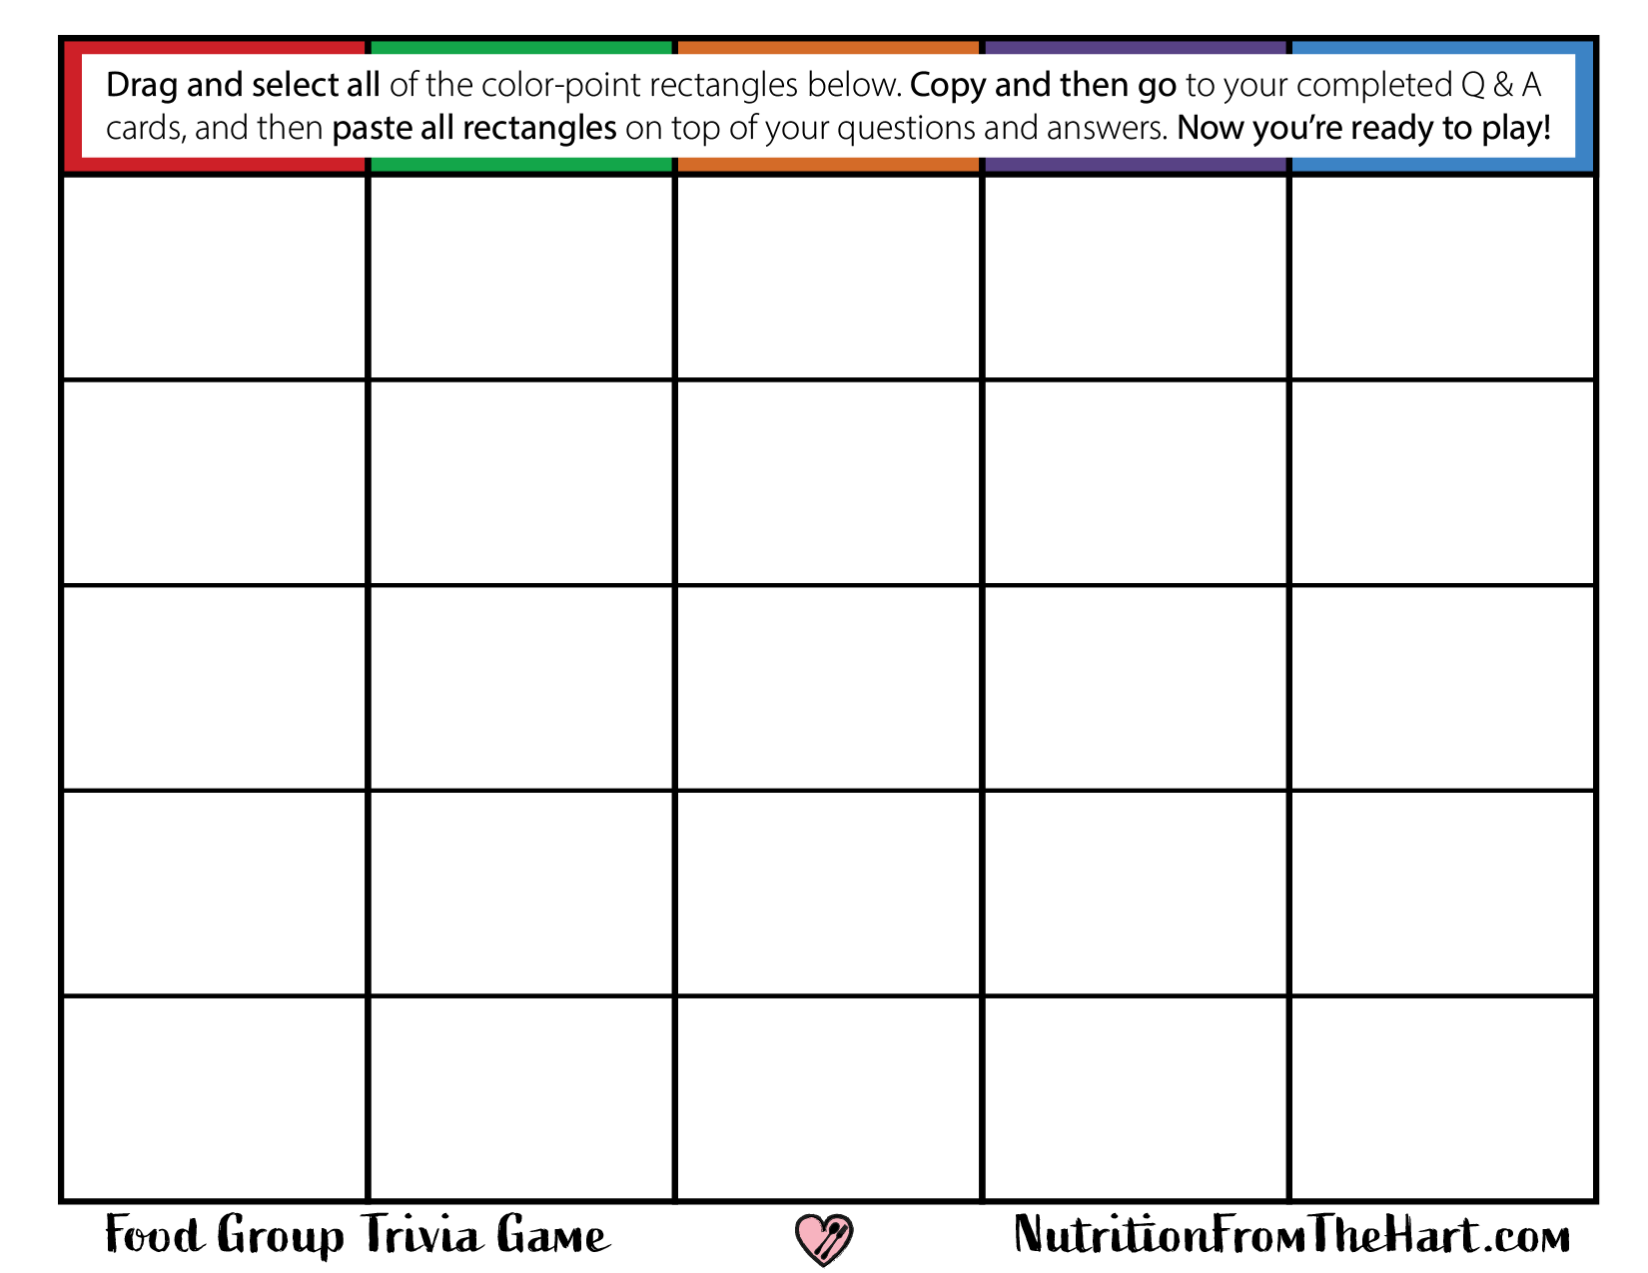

























Notes:
Step 1: Type clues in each box. Step 2: Type your answers in the boxes on Slide Two. Step 3: Select ALL color point cards, and then copy the cards from Slide Three. Step 4: Paste the cards over your clues on Slide One and your answers on Slide Two.

